Slide 1
Multi-Agent Planning to Detect Obstacles and Navigate in an Unknown Environment
By:
Shantnav Agarwal | Shlok Deshmukh | Manupriya Singh | Alexandros Theocharous
Image created by Dall-E

Slide 2
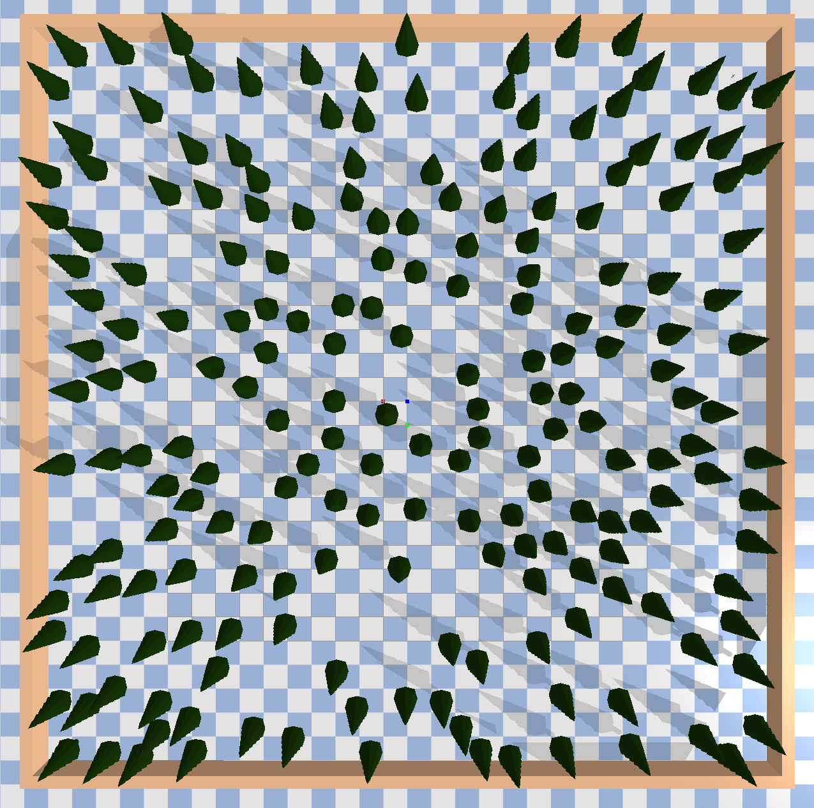
Forest Environment

Slide 3
Global Planner

Slide 4
RRT*

